Slide 1
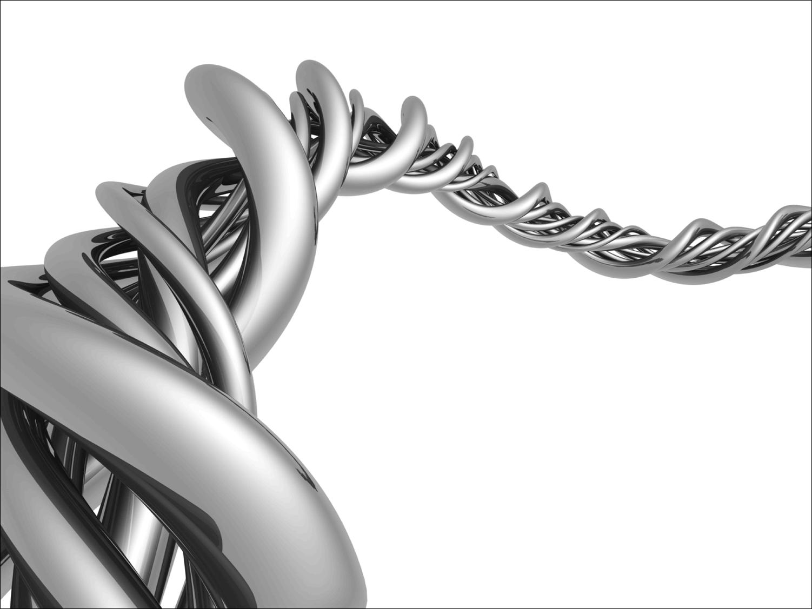
Fundamentals of Python:
First Programs
Chapter 9: Graphical
User Interfaces

Slide 2

Objectives
After completing this chapter, you will be able to:
Structure a GUI-based program using the model/view/controller pattern
Instantiate and lay out different types of window objects, such as labels, entry fields, and command buttons, in a window’s frame
Define methods that handle events associated with window objects
Organize sets of window objects in nested frames
Fundamentals of Python: First Programs

Slide 3
Introduction
Most modern computer software employs a graphical user interface or GUI
A GUI displays text as well as small images (called icons) that represent objects such as directories, files of different types, command buttons, and drop-down menus
In addition to entering text at keyboard, the user of a GUI can select an icon with pointing device, such as mouse, and move that icon around on the display
Fundamentals of Python: First Programs

Slide 4
The Behavior of Terminal-Based Programs and GUI-Based Programs
Two different versions of the bouncy program from a user’s point of view:
  Terminal-based user interface
  Graphical user interface
Both programs perform exactly the same function
  However, their behavior, or look and feel, from a user’s perspective are quite different
Fundamentals of Python: First Programs

Slide 5
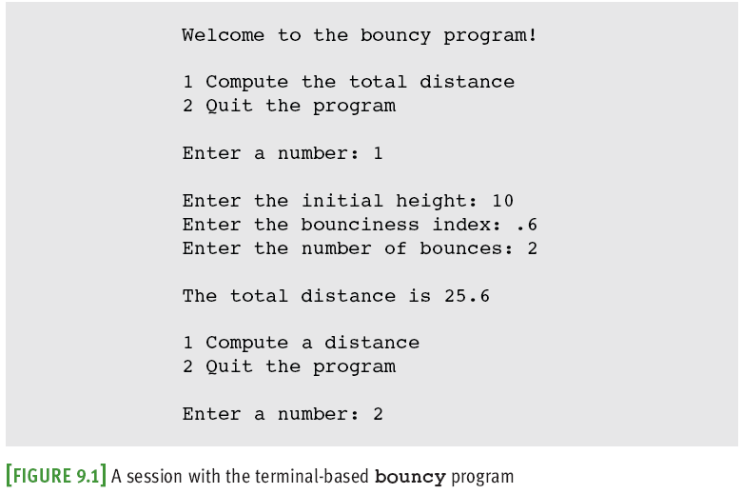
The Terminal-Based Version
Fundamentals of Python: First Programs

Slide 6
The Terminal-Based Version (continued)
Problems:
  User is constrained to reply to a definite sequence of prompts for inputs
    Once an input is entered, there is no way to change it
  To obtain results for a different set of input data, user must wait for command menu to be displayed again
    At that point, the same command and all of the other inputs must be re-entered
  User can enter an unrecognized command
Fundamentals of Python: First Programs

Slide 7
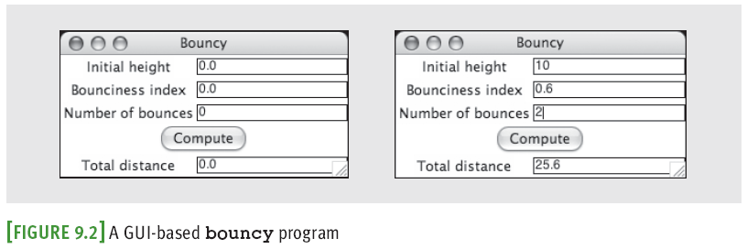
The GUI-Based Version
Uses a window that contains various components
  Called window objects or widgets
Solves problems of terminal-based version
A label
An entry field
A command button
Title bar
Can be dragged to resize window
Fundamentals of Python: First Programs

Slide 8
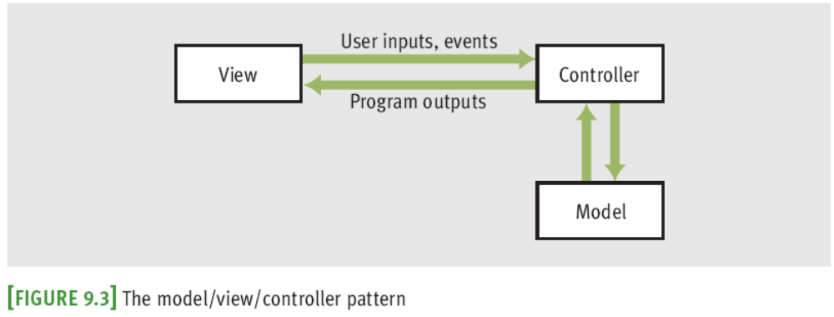
Event-Driven Programming
User-generated events (e.g., mouse clicks) trigger operations in program to respond by pulling in inputs, processing them, and displaying results
  Event-driven software
  Event-driven programming
Fundamentals of Python: First Programs

Slide 9
Event-Driven Programming (continued)
Coding phase:
  Define a new class to represent the main window
  Instantiate the classes of window objects needed for this application (e.g., labels, command buttons)
  Position these components in the window
  Instantiate the data model and provide for the display of any default data in the window objects
  Register controller methods with each window object in which a relevant event might occur
  Define these controller methods
  Define a main that launches the GUI
Fundamentals of Python: First Programs

Slide 10
Coding Simple GUI-Based Programs
There are many libraries and toolkits of GUI components available to the Python programmer
  tkinter includes classes for windows and numerous types of window objects
  tkinter.messagebox includes functions for several standard pop-up dialog boxes
Fundamentals of Python: First Programs

Slide 11
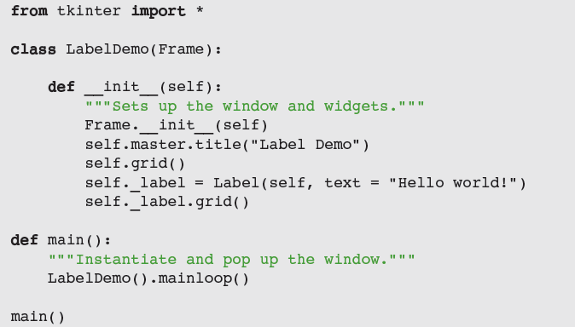
Windows and Labels
A grid layout allows programmer to place components in the cells of an invisible grid
Fundamentals of Python: First Programs

Slide 12
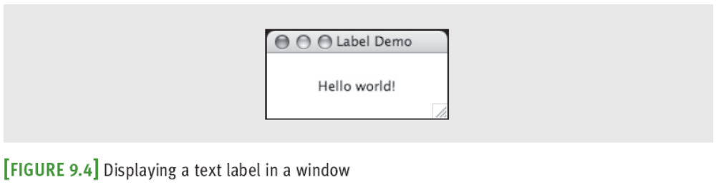
Windows and Labels (continued)
The GUI is launched in the main method
  Instantiates LabelDemo and calls mainloop
mainloop method pops up window and waits for user events
  At this point, the main method quits (GUI is running a hidden, event-driven loop in a separate process)
Fundamentals of Python: First Programs

Slide 13
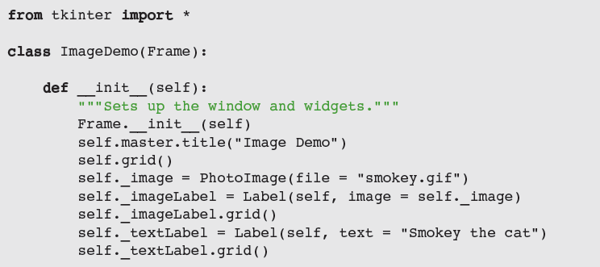
Displaying Images
Steps to create a label with an image:
  __init__ creates an instance of PhotoImage from a GIF file on disk
  The label’s image attribute is set to this object
Fundamentals of Python: First Programs

Slide 14
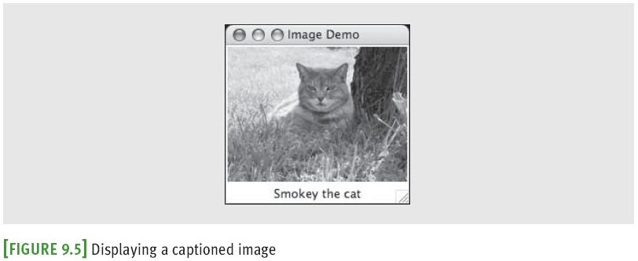
Displaying Images (continued)
The image label is placed in the grid before the text label
The resulting labels are centered in a column in the window
Fundamentals of Python: First Programs

Slide 15
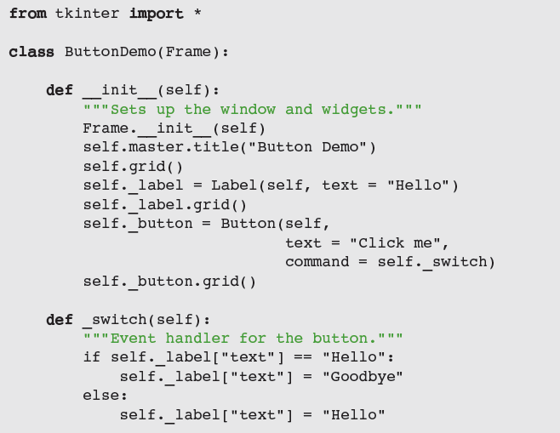
Command Buttons and Responding to Events
Fundamentals of Python: First Programs

Slide 16
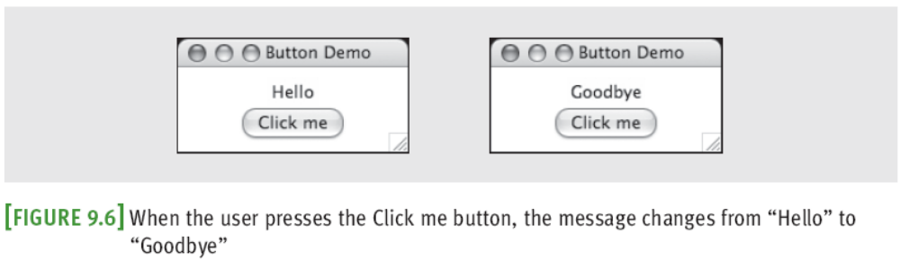
Command Buttons and Responding to Events (continued)
A button can display either text or an image
To activate a button and enable it to respond to clicks, set command to an event-handling method
  In this case, _switch examines the text attribute of the label and sets it to the appropriate value
    Attributes are stored in a dictionary
Fundamentals of Python: First Programs

Slide 17
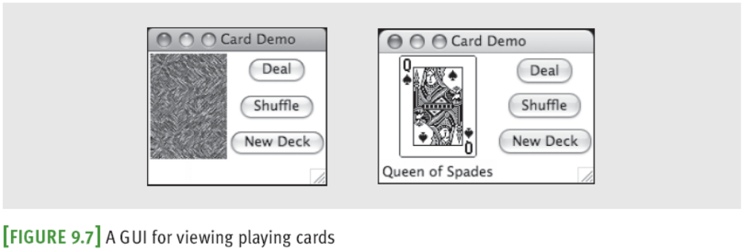
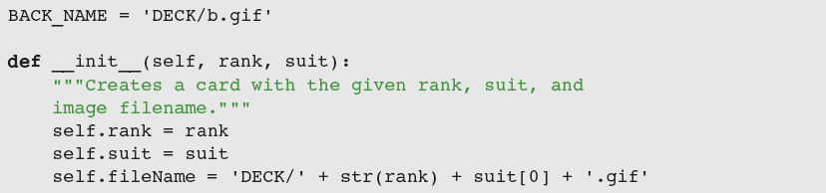
Viewing the Images of Playing Cards
Fundamentals of Python: First Programs

Slide 18
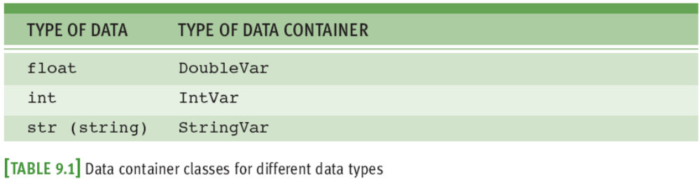
Entry Fields for the Input and Output of Text
A form filler consists of labeled entry fields, which allow the user to enter and edit a single line of text
A field can also contain text output by a program
tkinter’s Entry displays an entry field
Three types of data container objects can be used with Entry fields:
Fundamentals of Python: First Programs

Slide 19
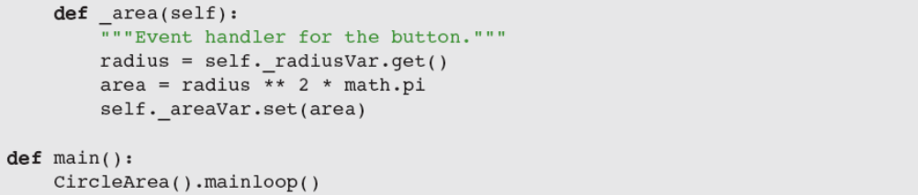
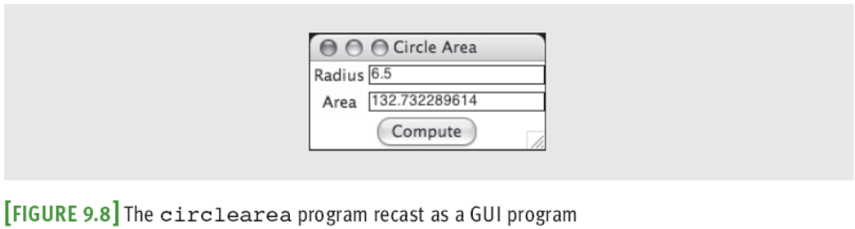
Entry Fields for the Input and Output of Text (continued)
Fundamentals of Python: First Programs

Slide 20
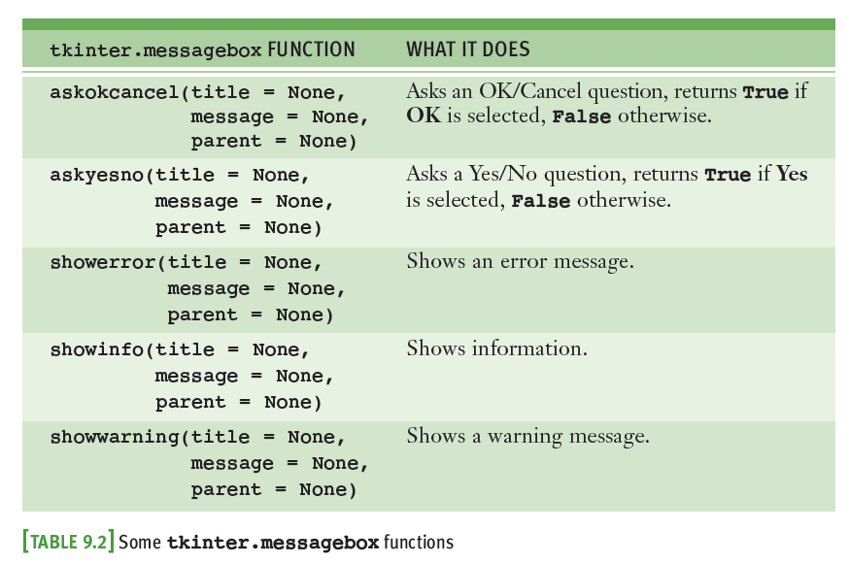
Using Pop-up Dialog Boxes
Fundamentals of Python: First Programs

Slide 21
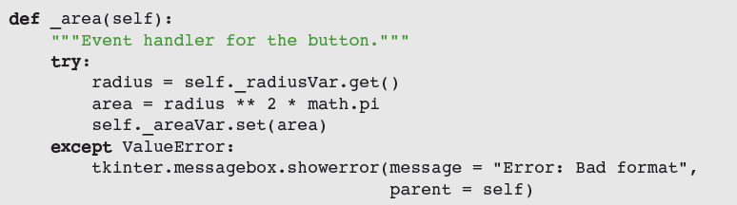
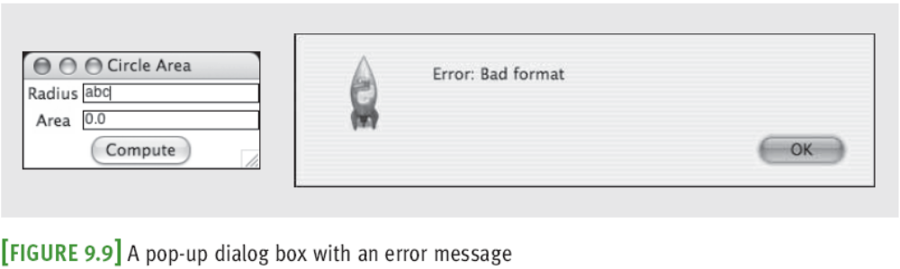
Using Pop-up Dialog Boxes (continued)
Fundamentals of Python: First Programs

Slide 22
Case Study: A GUI-Based ATM
Request:
  Replace the terminal-based interface of the ATM program with a GUI
Analysis:
  There are no new classes, although the ATM class now extends the Frame class
Design:
  Instead of implementing a text-based, menu-driven command processor, ATM now implements a GUI-based, event-driven command processor
    _login and _logout
Fundamentals of Python: First Programs

Slide 23
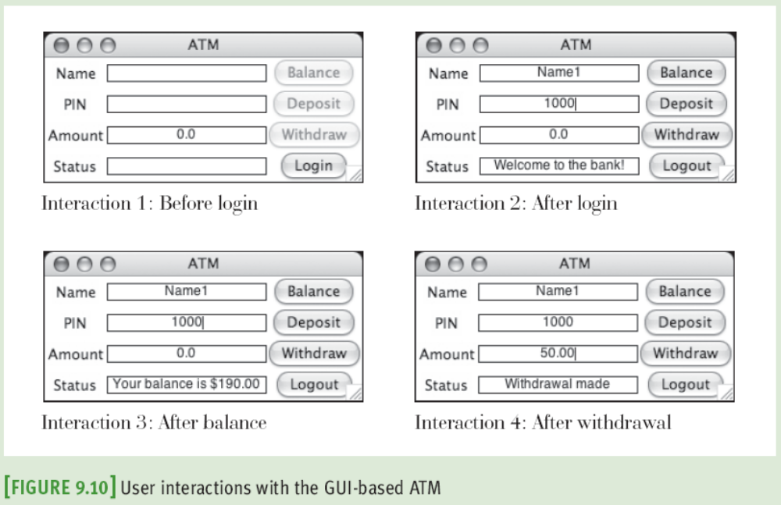
Case Study: A GUI-Based ATM (continued)
Fundamentals of Python: First Programs

Slide 24
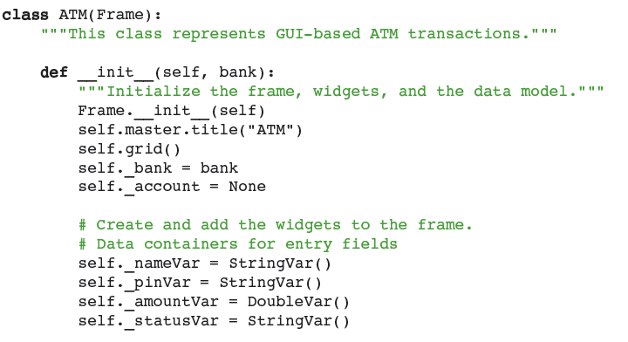
Case Study: A GUI-Based ATM (continued)
Implementation (Coding):
Fundamentals of Python: First Programs

Slide 25
Other Useful GUI Resources
Layout of GUI components can be specified in more detail
  Groups of components can be nested in panes
Paragraphs can be displayed in scrolling text boxes
Lists of information can be presented for selection in scrolling list boxes and drop-down menus
Color, size, and style of text and of some GUI components can be adjusted
GUI-based programs can be configured to respond to various keyboard events and mouse events
Fundamentals of Python: First Programs

Slide 26
Colors
tkinter module supports the RGB
  Values expressed in hex notation (e.g., #ff0000)
  Some commonly used colors have been defined as string values (e.g., "white", "black", "red")
For most components, you can set two color attributes:
  A foreground color (fg) and a background color (bg)
Fundamentals of Python: First Programs

Slide 27
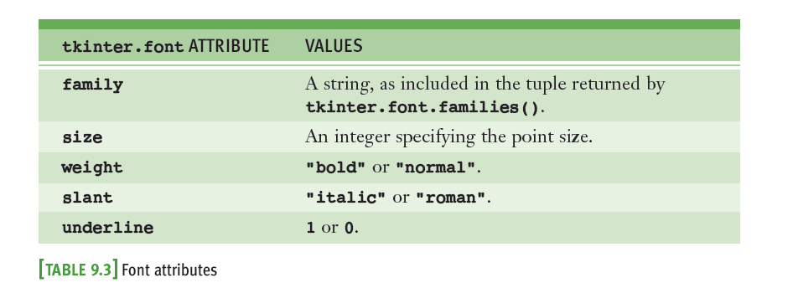
Text Attributes
The text displayed in a label, entry field, or button can also have a type font
Fundamentals of Python: First Programs

Slide 28

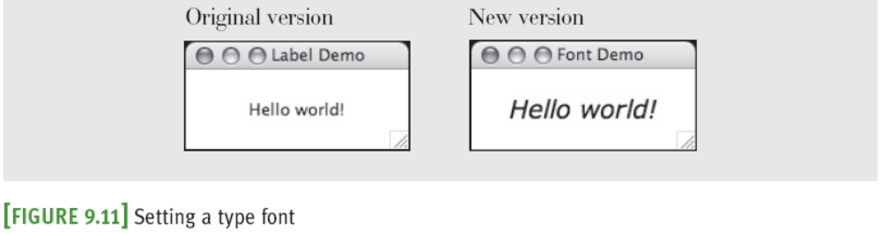
Text Attributes (continued)
Example:
Fundamentals of Python: First Programs

Slide 29
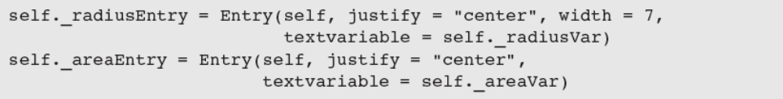
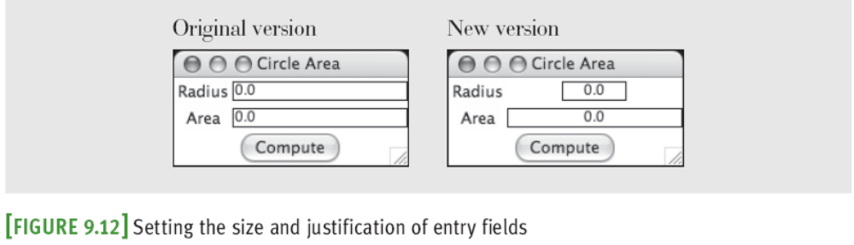
Sizing and Justifying an Entry
It’s common to restrict the data in a given entry field to a fixed length; for example:
  A nine-digit number for a Social Security number
Fundamentals of Python: First Programs

Slide 30
Sizing the Main Window
To set the window’s title:
  self.master.title(<a string>)
Two other methods, geometry and resizable, can be run with the root window to affect its sizing
  self.master.geometry("200x100")
  self.master.resizable(0, 0)
Generally, it is easiest for both the programmer and the user to manage a window that is not resizable
  Some flexibility might occasionally be warranted
Fundamentals of Python: First Programs

Slide 31
Grid Attributes
By default, a newly opened window shrink-wraps around its components and is resizable
  When window is resized, the components stay shrink-wrapped in their grid
    Grid remains centered within the window
    Widgets are also centered within their grid cells
Occasionally,
  A widget must be aligned to left/right of its grid cell,
  Grid must expand with surrounding window, and/or
  Components must expand within their cells
Fundamentals of Python: First Programs

Slide 32

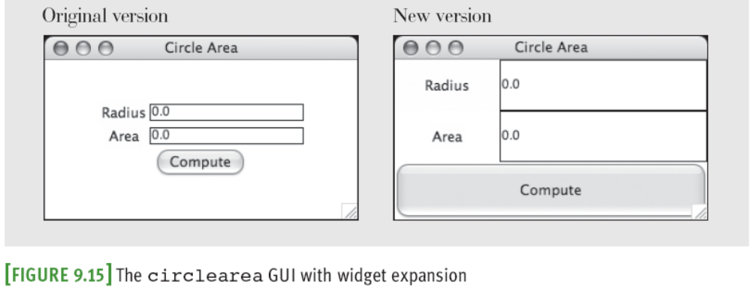
Grid Attributes (continued)
Fundamentals of Python: First Programs

Slide 33
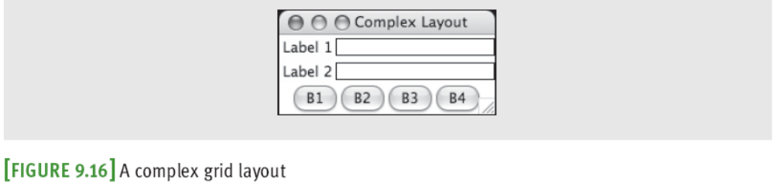
Using Nested Frames to Organize Components
Suppose a GUI requires a row of command buttons beneath two columns of labels and entry fields:
It is difficult, but not impossible, to create this complex layout with a single grid
Alternative: decompose window into two nested frames (panes), each containing its own grid
Fundamentals of Python: First Programs

Slide 34
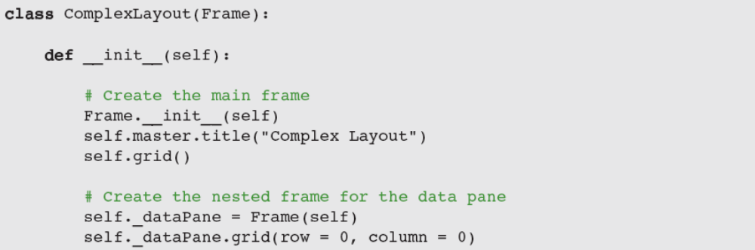
Using Nested Frames to Organize Components (continued)
The new frame is then added to its parent’s grid and becomes the parent of the widgets in its own grid
Fundamentals of Python: First Programs

Slide 35
Multi-Line Text Widgets
Use Text widget to display multiple lines of text
  wrap attribute → CHAR (default), WORD, or NONE
  Widget can expand with its cell; alternative: scroll bars
Text within a Text widget is accessed by index positions (specified as strings):
  "rowNumber.characterNumber"
insert is used to send a string to a Text widget:
  output.insert("1.0", "Pythonƒrules!")
  output.insert(END, "Pythonƒrules! ")
delete can be used to clear a Text widget:
  output.delete("1.0", END)
Fundamentals of Python: First Programs

Slide 36
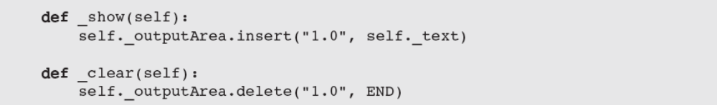
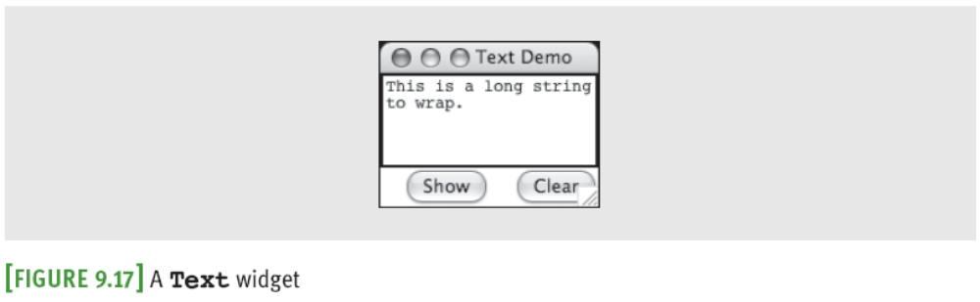
Multi-Line Text Widgets (continued)
Fundamentals of Python: First Programs

Slide 37
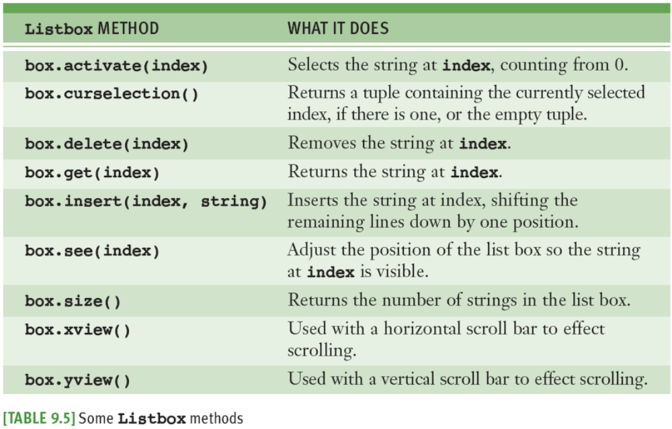
Scrolling List Boxes
Fundamentals of Python: First Programs

Slide 38
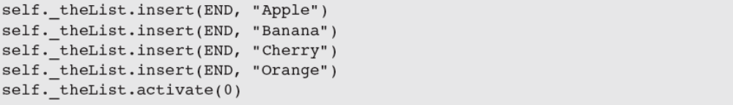
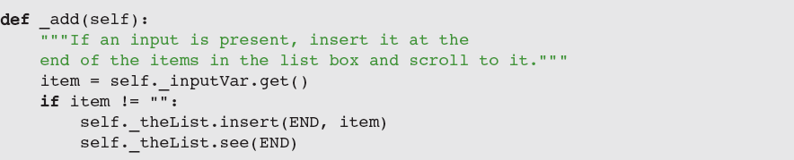
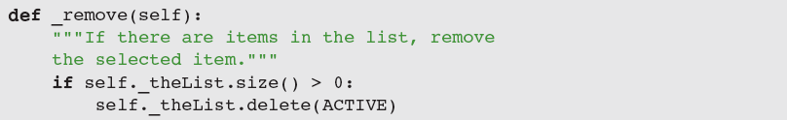
Scrolling List Boxes (continued)
Fundamentals of Python: First Programs

Slide 39
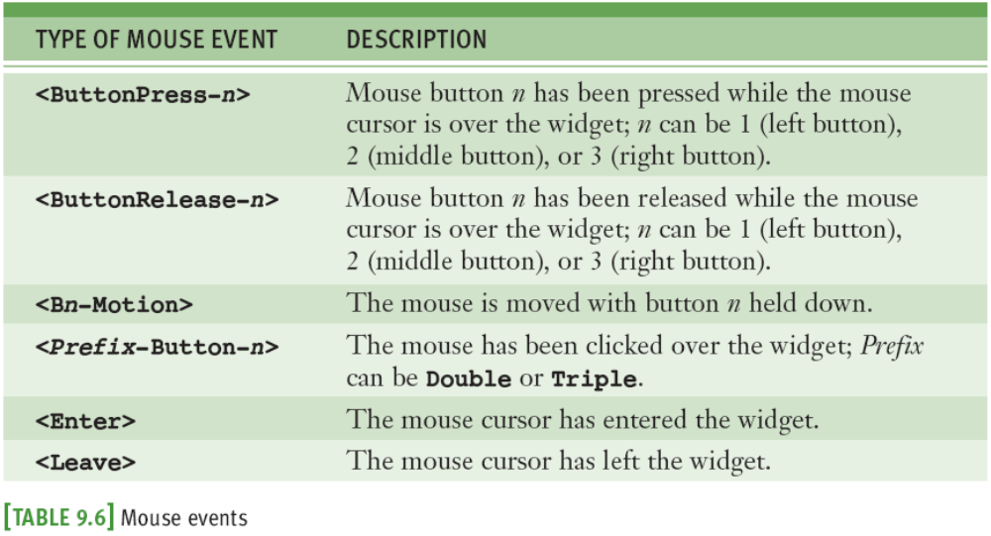
Mouse Events
Fundamentals of Python: First Programs

Slide 40
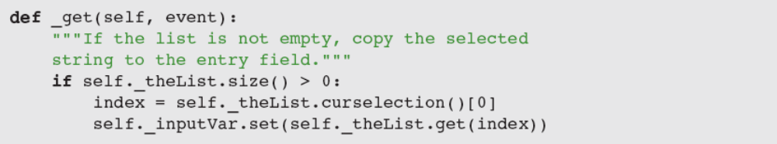
Mouse Events (continued)
Associate a mouse event and an event-handling method with a widget by calling the bind method:
  self._theList.bind("<ButtonRelease-1>", self._get)
Now all you have to do is define the _get method
  Method has a single parameter named event
Fundamentals of Python: First Programs

Slide 41
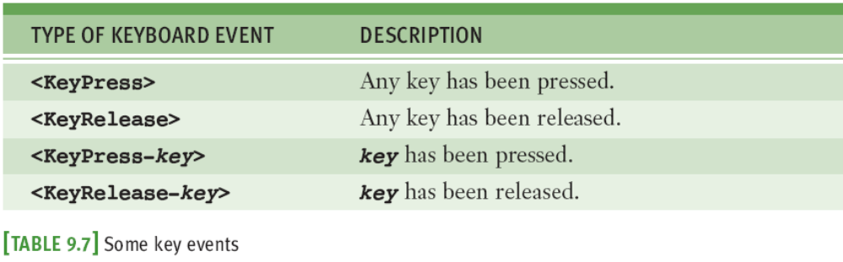
Keyboard Events
GUI-based programs can also respond to various keyboard events:
Example: to bind the key press event to a handler
  self._radiusEntry.bind("<KeyPress-Return>",
  lambda event: self._area())
Fundamentals of Python: First Programs

Slide 42
Summary
A GUI-based program responds to user events by running methods to perform various tasks
  The model/view/controller pattern assigns the roles and responsibilities to three different sets of classes
tkinter module includes classes, functions, and constants used in GUI programming
A GUI-based program is structured as a main window class (extends the Frame class)
Examples of window components: labels, entry fields, command buttons, text areas, and list boxes
Fundamentals of Python: First Programs

Slide 43
Summary (continued)
Pop-up dialog boxes display messages and ask yes/no question (tkinter.messagebox module)
Objects can be arranged using grids and panes
Each component has attributes for the foreground color and background color
Text has a type font attribute
The command attribute of a button can be set to a method that handles a button click
Mouse and keyboard events can be associated with handler methods for window objects (bind)
Fundamentals of Python: First Programs

